Slide 1

Azure Infrastructure, VMs, Networking and ARM for Linux
Microsoft Azure
William Eastbury
Technical Evangelist – DX
 William.Eastbury@Microsoft.com
 /in/willeastbury
 @WillEastbury

Slide 2
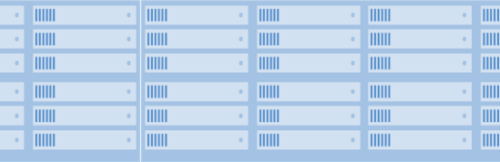
Microsoft Azure & Azure Stack
Platform Services
Platform Services
Developers
Security and Management
Hybrid
Operations
Security and Management
Hybrid
Operations
Cloud-inspired Infrastructure
Powered by Windows Server, Hyper-V, System Center, and Azure
One Azure ecosystem
Infrastructure Services
Unified app development
Compute
Storage
Network
Azure services in your datacenter
Compute
Storage
Network
Your Datacenter Infrastructure
Azure Global Datacenters
Operations
Microsoft Azure Stack
and Cloud Platform System
Microsoft Azure Cloud
Public, Global, Shared
Notes:
Public Cloud, Private Cloud, On-Premises – it’s not either-or and the world is never just black or white
It’s your choice and Microsoft offers a hybrid cloud solution that is tailor-made for your organization and your applications
Microsoft Azure Stack is a new hybrid cloud platform product that enables your organization to deliver Azure services from your own datacenter to help you achieve more
Get the power of cloud services, yet maintain control of your datacenter for true hybrid cloud agility
You decide where to keep your data and applications - in your own datacenter or with a hosting service provider
Easily access public cloud resources to scale at busy times of the year, for dev-test, or whenever you need them
Only Microsoft builds and runs its own hyper-scale datacenters and delivers that proven innovation to your datacenter

Slide 3
Supported Linux Distributions in Azure What can I deploy?
Notes:
Speak to speed of service development in IaaS as well.
Speak about cattle and pets – as we move to the cloud, we need to deploy ‘disposable servers’

Slide 4

Supported Linux Distributions in Azure
{Linux}
Distribution | Version
CentOS by OpenLogic | CentOS 6.3+, 7.0+
CoreOS | 494.4.0+
Debian | Debian 7.9+, 8.2+
Oracle Linux | 6.4+, 7.0+
Red Hat Enterprise Linux | RHEL 6.7+, 7.1+
SUSE Linux Enterprise | SLES 11 SP4, SLES 12 SP1+ and SLES for SAP+
openSUSE | openSUSE Leap 42.1+
Ubuntu | Ubuntu 12.04, 14.04, 16.04, 16.10
The Azure platform SLA applies to virtual machines running the Linux OS only when one of the endorsed distributions is used. All Linux distributions that are provided in the Azure image gallery are endorsed distributions with the required configuration.
See: https://docs.microsoft.com/en-us/azure/virtual-machines/virtual-machines-linux-endorsed-distros?toc=%2fazure%2fvirtual-machines%2flinux%2ftoc.json
@WillEastbury
Notes:
Then open portal and demo
https://msdn.microsoft.com/en-us/powershell/dsc/LnxGettingStarted
Canonical will deploy Ubuntu for you later

Slide 5

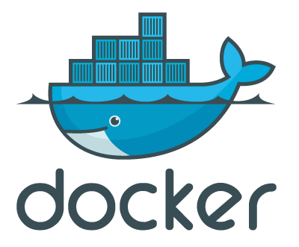
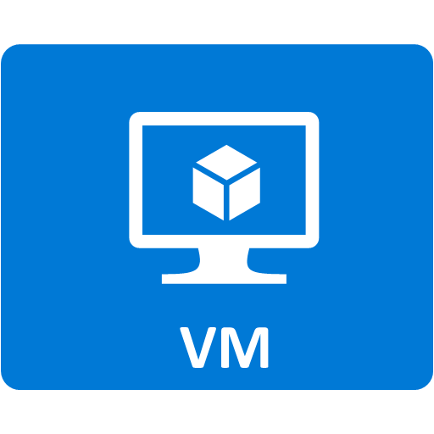
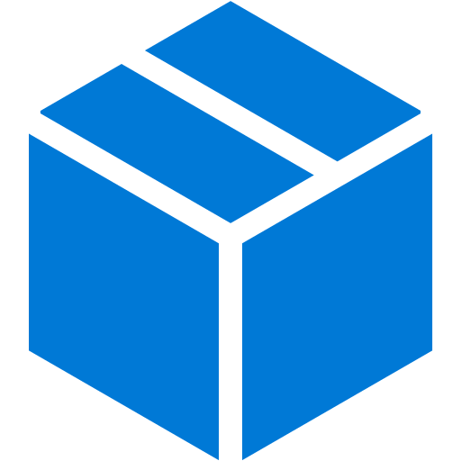





















Linux Images in Azure
Azure
Marketplace
Docker Hub
Integration
Endorsed +
Partner stacks
Endorsed +
Partner stacks
Discrete containers
Red Hat
Enterprise
Linux
OpenLogic
CentOS-based
CoreOS
SUSE Linux
Enterprise
Server
Meet your developers’ needs
Ubuntu
openSUSE
Custom
VHD
Pre-existing images
Purpose built
Oracle
Linux
KVM
VMWare
Hyper-V
Packer + Azure CLI
Debian
Notes:
Azure Endorsed Linux Distributions
Published, maintained and supported by partners
Curated & tested by Microsoft
Most endorsed distros maintain repos in each Azure region for fast updating
Standard Images
Premium Images

Slide 6
Automating Infrastructure Deployment with PowerShell DSC and ARM Templates
Notes:
Speak to speed of service development in IaaS as well.
Speak about cattle and pets – as we move to the cloud, we need to deploy ‘disposable servers’
OpenJDK/Tomcat on Ubuntu
https://portal.azure.com/#create/Microsoft.Template/uri/https%3A%2F%2Fraw.githubusercontent.com%2FAzure%2Fazure-quickstart-templates%2Fmaster%2Fopenjdk-tomcat-ubuntu-vm%2Fazuredeploy.json
Talk through the azure-quickstart-templates github repo

Slide 7
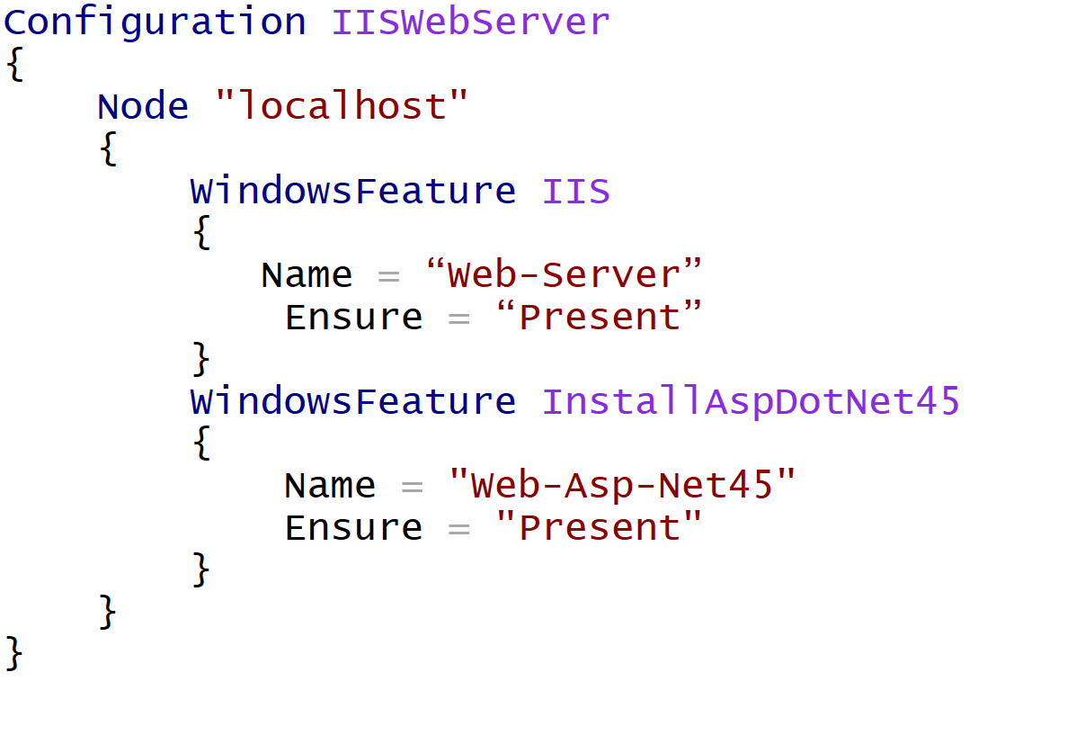
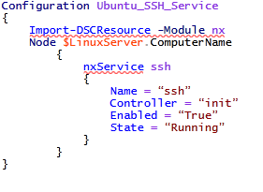
PowerShell DSC In VM - Deployment Automation
{DSC}
PowerShell DSC Script – Windows / IIS / ASP.NET
PowerShell DSC Script – Enable SSH Service
@WillEastbury
Notes:
Then open portal and demo
https://msdn.microsoft.com/en-us/powershell/dsc/LnxGettingStarted

Slide 8
“Now life is simple to deploy resources. BUT the content of those resources are already far too complicated, so lets try and express everything declaratively in PowerShell.”
PowerShell Desired State Configuration
Implementation Team
@WillEastbury
Notes:
The theme for the afternoon will be.

Slide 9
Azure Resource Manager Deploying infrastructure and configuration as code
Notes:
The infrastructure for your application is typically made up of many components – maybe a virtual machine, storage account, and virtual network, or a web app, database, database server, and 3rd party services.
You do not see these components as separate entities, instead you see them as related and interdependent parts of a single entity. You want to deploy, manage, and monitor them as a group.
DevOps Deployment Automation - Requires a faster, more flexible deployment approach than the old ASM gateway and powershell could provide – ASM PowerShell can be very complex to define and troubleshoot.

Slide 10
How I want the world to look… {World}
Azure Resource Manager Implementation Team
Notes:
The theme for the afternoon will be.

Slide 11
“Life is already really complicated, so we insist on making it even more complicated.”
Azure Service Management APIs Design Team
@WillEastbury
Notes:
The theme for the afternoon will be.

Slide 12
“Life is now even more complicated, so lets try and make it simpler by implementing a common backplane.”
Azure Resource Manager Design Team
@WillEastbury
Notes:
The theme for the afternoon will be.

Slide 13
“Having schemas for everything is too complicated, so lets try and express everything in a single JSON schema.”
Azure Resource Manager Implementation Team
@WillEastbury
Notes:
The theme for the afternoon will be.

Slide 14
Azure Service Management vs Azure Resource Manager
{World}
ASM – Imperative infrastructure deployment
"Dear Azure, here's a list of everything I want you do, in excruciating detail“
ARM - Declarative desired-state deployment
"Dear Azure, here's what I want it to look like - go, make it happen"
Notes:
ARM does desired-state deployment of resources. It does not do desired-state configuration inside these resources (e.g., VMs), although it can initiate the process of desired-state configuration.
ONE API to deploy EVERYTHING
Faster Deployments – ARM can deploy in true parallel as compared to semi-sequential in ASM
RBAC is fully integrated with AAD – and is a long-requested feature.
Resource-provider model is intended to be fully extensible.
Common interface for Azure and Azure Stack – When Azure Stack is released, same API model for on-premises and Cloud

Slide 15
Why ARM, what does it mean to me ?
{My.World}
The infrastructure for your application is typically made up of many components – maybe a virtual machine, storage account, and virtual network, or a web app, database, database server, and 3rd party services.
You do not see these components as separate entities, instead you see them as related and interdependent parts of a single entity. You want to deploy, manage, and monitor them as a group.
DevOps Deployment Automation - Requires a faster, more flexible deployment approach than the old ASM gateway and powershell could provide – ASM PowerShell can be very complex to define and troubleshoot.
It can be difficult to provision multi-identity resources with multiple azure AD federated identities in the classic portal.
Enable Cookie-Cutter deployment by ‘stamp’ methodologies via templates.

Slide 16
ARM, the solution to deploy heterogenous cloud resources
{[Country], [Planet],[PC]}
Azure Resource Manager enables you to work with the resources in your solution as a group. You can deploy, update or delete all of the resources for your solution in a single, coordinated operation.
You can repeatedly deploy your application throughout the app lifecycle and have confidence your resources are deployed in a consistent state.
You can use declarative templates to define your deployment and you can define the dependencies between resources so they are deployed in the correct order.
You can apply access control to all resources in your resource group because Role-Based Access Control (RBAC) is natively integrated into the management platform.
You can apply tags to resources to logically organize all of the resources in your subscription

Slide 17
Azure Resource Manager API Resource limits
{World}
When using Resource Groups, limits that once were global become managed at a regional level with the Azure Resource Manager.
It is important to emphasize that quotas for resources in Azure Resource Groups are per-region accessible by your subscription, and are not per-subscription, as the service management quotas are.
https://azure.microsoft.com/en-gb/documentation/articles/azure-subscription-service-limits/

Slide 18
Azure Resource Manager and Role Based Access Control
{World}
In classic Azure (ASM), you can set and manage permissions – but only to the granularity of admin and service admin of the whole subscription.
Azure Role-Based Access Control (RBAC) enables fine-grained access management for Azure.
Using RBAC, you can segregate duties within your DevOps team and grant only the amount of access to users that they need to perform their jobs.
https://azure.microsoft.com/en-us/documentation/articles/role-based-access-control-configure/

Slide 19
Azure Resource Manager API and Portal restrictions
{World}
Azure Resource Manager provides a new way for you to deploy and manage the services that make up your applications, most, but not all, services support Resource Manager, and some services support Resource Manager only partially.
Microsoft will enable Resource Manager for every service that is important for future solutions, but until the support is consistent, you need to know the current status for each service.
https://azure.microsoft.com/en-us/documentation/articles/resource-manager-supported-services/

Slide 20
Azure Resource Manager Deployment methodology
{World}|Azure
An ARM template is a JSON formatted document that can be deployed to create a ring-fenced group of resources
Can, and should be parameterised
You could Build an ARM template by hand (!)
Are iterative (Multiple templates can be used to build up a solution)
Notes:
https://azure.microsoft.com/en-us/documentation/articles/resource-group-audit/

Slide 21
Azure Resource Manager Templates
{ARM Universe: {[World],[World]}}
SQL-A
Instantiation of repeatable config.
Configuration → Resource Group
What?
Source file, can be checked-in
Specifies resources, dependencies and connections
Parameterized input/output
Why?
Ensure Idempotency
Simplify orchestration
Provide cross-resource configuration and update support
Website
[SQL CONFIG] VM (2x)
DEPENDS ON SQL
DEPENDS ON SQL
SQL - A
Website
Virtual
Machines
SQL
C
ONFIG
Notes:
Written in JSON, describes entities
Template execution engine can interpret dependencies and relationships and orchestrate the deployment of the resources for you
Resources at the bottom of the stack are deployed first
Idempotent, can redeploy and get the same goal state
Parameterized input and output – reuse template in different environments
Templates are represented in the gallery

Slide 22
Azure Resource Manager Templates
{Universe: {[parameters(‘worldname’)}}
{
"$schema": "https://schema.management.azure.com/schemas/2015-01-01/deploymentTemplate.json#",
"contentVersion": "1.0.0.0",
"parameters": {
"storageAccounts_willstestfiles_name": {
"defaultValue": "willstestfiles",
"type": "String"
}
},
"variables": {},
"resources": [
{
"comments": "Generalized from resource: '/subscriptions/389f74ca-43b9-4ce7-abbd-6bf070c8de3b/resourceGroups/willstestfiles/providers/Microsoft.Storage/storageAccounts/willstestfiles'.",
"type": "Microsoft.Storage/storageAccounts",
"name": "[parameters('storageAccounts_willstestfiles_name')]",
"apiVersion": "2015-06-15",
"location": "northeurope",
"tags": {},
"properties": {
"accountType": "Standard_RAGRS"
},
"dependsOn": []
}
]
}
Notes:
Written in JSON, describes entities
Template execution engine can interpret dependencies and relationships and orchestrate the deployment of the resources for you
Resources at the bottom of the stack are deployed first
Idempotent, can redeploy and get the same goal state
Parameterized input and output – reuse template in different environments
Templates are represented in the gallery

Slide 23
Azure Resource Manager Further Reading
Read({World})
Azure QuickStarts https://azure.microsoft.com/en-us/documentation/templates/
ARMViz.io
Export From Azure Web App Deployment wizard
Visual Studio Templates (With appropriate Azure SDK version installed)
Preview: Export Resource Group Template
https://azure.microsoft.com/en-us/documentation/articles/resource-group-authoring-templates/
http://download.microsoft.com/download/8/E/1/8E1DBEFA-CECE-4DC9-A813-93520A5D7CFE/World%20Class%20ARM%20Templates%20-%20Considerations%20and%20Proven%20Practices.pdf
https://azure.microsoft.com/en-us/documentation/articles/resource-group-template-functions/

Slide 24
Creating a resource group from bash and the Azure CLI.
Demo
Notes:
Bash
sudo npm install -g azure-cli
azure login
azure account set "External Demo Subscription“
azure group create --name "Willslinuxrg" --location "UK South"

Slide 25
“Now life is simple to deploy and build resources. But connecting them together and securing them is far too complicated, so lets talk Virtual Networks.”
Azure Virtual Networking
Implementation Team
@WillEastbury
Notes:
The theme for the afternoon will be.

Slide 26
Networking Choices Connecting your machines and virtual networks together

Slide 27
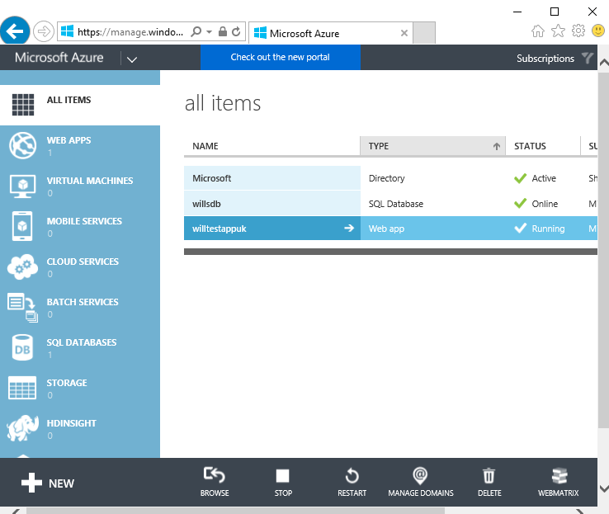
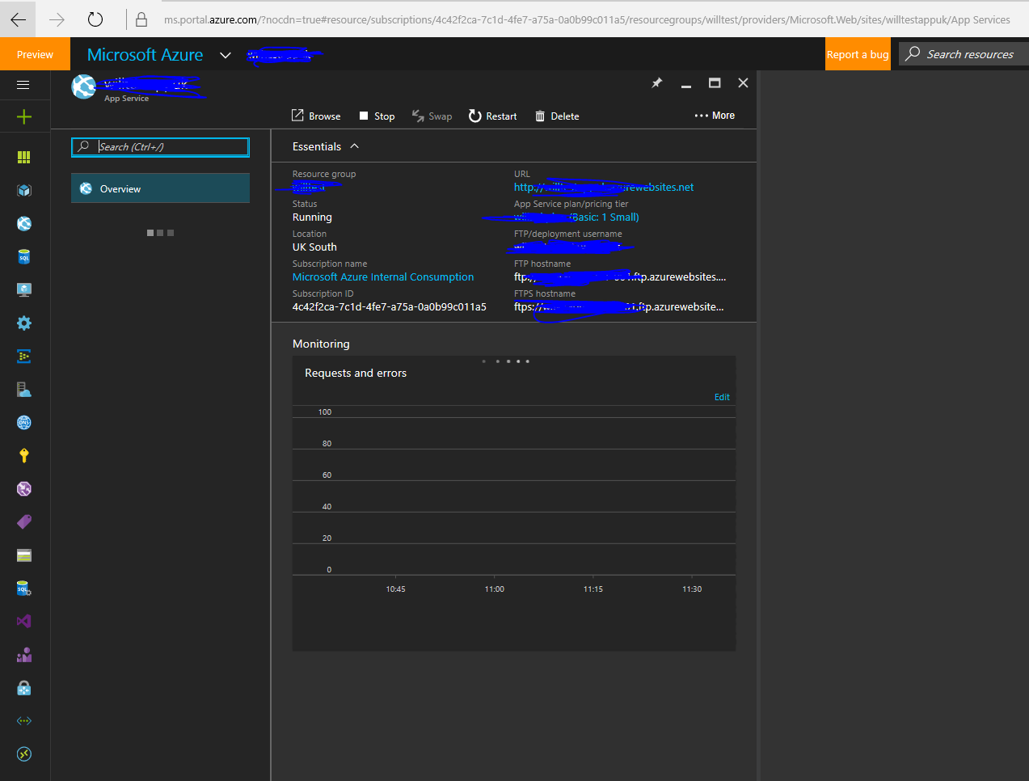
Virtual Machine Networking Options
Classic (or ASM)
Standalone VM, configure Endpoints per VM
VM(s) on a Virtual Network, configure as a Set
Azure Resource Manager (or ARM)
All VMs must be on a Virtual Network, even standalone VMs

Slide 28
Network Connectivity Options
Virtual Private Network Gateway
Consider On-Premise Device regarding Static and Dynamic vs High-Performance VPN gateways
Not all devices can support multiple IPSec tunnels
Expose an SSL Endpoint
(and unlock it via your Network Security Group)
ExpressRoute Connections
VNet to VNet Peering
Hybrid Connection Options
TCP Bridge / Service Bus Based
A.K.A. BizTalk Hybrid Connections,
Service Bus Relay
Notes:
How can I connect to my Virtual Machines
Comment on Cisco ASA Static only

Slide 29
IaaS Networking – Things to remember
Network Security Groups
Use Network Security Groups to lock down your (multiple) subnets internally and externally.
Multicast traffic is not supported.
Ask yourself - can I just expose an SSL secured endpoint ?
VPN / ExpressRoute connections will expose EVERYTHING by default behind the gateway to your internal network.
You will definitely want to lock them down with an NSG.
ExpressRoute connections have significantly lower connection latency than VPN
VPN Transit routing is only supported in some circumstances.
VNet peering can be used to connect VNets together without a VPN gateway.
Consider Gateway / WAF appliances such as a Barracuda, F5 or Application Gateway
Notes:
bash cmd
sudo npm install -g azure-cli
azure login
azure account set "External Demo Subscription“
azure group create --name "Willslinuxrg" --location "UK South"
azure network vnet create --resource-group "Willslinuxrg" --name "WillsVnet“ –location “UK South”
azure network vnet create --resource-group "Willslinuxrg" --location "UK South" --name "WillsdemoNet" --address-prefixes “192.168.0.0/16“
azure network vnet subnet create --resource-group "Willslinuxrg" --vnet-name "WillsdemoNet" --name "BackNet" --address-prefix “192.168.1.0/24"
azure network vnet show

Slide 30
Creating a Virtual Network from the Azure CLI.
Demo
Notes:
azure network vnet create --resource-group "Willslinuxrg" --name "WillsVnet“ –location “UK South”
azure network vnet create --resource-group "Willslinuxrg" --location "UK South" --name "WillsdemoNet" --address-prefixes “192.168.0.0/16“
azure network vnet subnet create --resource-group "Willslinuxrg" --vnet-name "WillsdemoNet" --name "BackNet" --address-prefix “192.168.1.0/24"
azure network vnet subnet create --resource-group "Willslinuxrg" --vnet-name "WillsdemoNet" --name “FrontNet" --address-prefix “192.168.2.0/24"
azure network vnet show --resource-group "Willslinuxrg" --name "WillsdemoNet“

Slide 31
“Now life is simple to deploy and build resources and connect them together. But which resources do I deploy?”
Azure Virtual Machines
Implementation Team
@WillEastbury
Notes:
The theme for the afternoon will be.

Slide 32
Performance Choices - VM Choosing the right Virtual Machine and Storage Combination

Slide 33
A Series - InfiniBand
SSD
HDD backed temporary drive
HDD backed boot volume
RDMA 40Gb/sec network configuration
Tuned for Message Passing Interface (MPI) applications
Intel® Xeon® E5 processors
Intel Xeon E5-2670 @ 2.6 GHZ
MIN: 8 core and 56GB RAM
MAX: 16 cores and 112GB RAM

Slide 34
Av2 Series
SSD
SSD backed temporary drive
HDD backed boot volume
A1…A2…A3
Better random IOPS (2-10x over A series v1) (but still throttled to 500 per disk)
New VM naming schema …
family + vCPU count
Core::RAM Ratio changed to 2GB / 8GB RAM per CPU
(from 1.75GB / 7GB RAM per CPU)
Notes:
In this new version of our A-Series VM’s we have raised the amount of RAM per vCPU from 1.75 GiB or 7 GiB of RAM per vCPU to 2 GiB or 8 GiB per vCPU.
We have also improved our local disk random IOPS to be 2-10x faster than that of our existing A version 1 sizes.
These new sizes use our new VM naming schema which is VM family letter followed by the number of vCPU’s of the VM. The ‘m’ identifier after the vCPU count signifies our High Memory offerings (8 GiB/vCPU). (e.g. Standard_A8m_v2)
it’s important to realize that the old Standard_A8 is succeeded by the new Standard_H8, not the A8_v2
The IOPS per disk are still throttled to

Slide 35
DS Series
SSD
SSD backed temporary drive
BOOT
SSD backed boot volume
SSD
D11:D14
Ideal for memory-intensive enterprise high IOPS applications
MIN: 1 core and 3.5GB RAM
MAX: 20 cores and 140GB RAM

Slide 36
Dv2 Series
SSD
SSD backed temporary drive
HDD backed boot volume
Haswell CPU core
E5-2673 v3 @ 2.4 – 3.1 GHz
i
H
~60% faster than A Series
MIN: 1 core and 3.5GB RAM
MAX: 20 cores and 140GB RAM
D5v2,D14v2 > 8,000 IOPS
D15v2 > 16,000 IOPS
SSD
Notes:
D5v2, D14v2, D15v2 – mega disk performance. 16 or 32x 500 iops stripes
In some regions, accelerated networking is available for the Standard_D15_v2 size.

Slide 37
F Series
SSD
SSD backed temporary drive
HDD backed boot volume
Haswell CPU core
E5-2673 v3 @ 2.4 – 3.1 GHz
$$$
Lower per-hour price
H
MIN: 1 core and 2GB RAM
MAX: 16 cores and 32GB RAM
F16 > 16,000 IOPS
2GB RAM and 16GB local SSD per core
Ideal for CPU intensive, but memory light apps with light IO requirements
i
Notes:
Lower per-hour price, based on the 2.4 GHz Intel Xeon®

Slide 38
FS Series
SSD
SSD backed temporary drive
BOOT
SSD backed boot volume
SSD
Haswell CPU core
E5-2673 v3 @ 2.4 – 3.1 GHz
SSD
F16s > 64,000 IOPS
H
MIN: 1 core and 2GB RAM
MAX: 16 cores and 32GB RAM
2GB RAM and 16GB local SSD per core
Ideal for CPU intensive, but memory light apps with heavy IO requirements
i

Slide 39
N Series
NC: Tesla K80 (4992 CUDA cores, 8.93 Teraflops single precision throughput). (Windows and Ubuntu)
NV: Tesla M60 (4096 CUDA cores, 36x 1080p H.264 streams) (Windows Only)
SSD
SSD backed temporary drive
NVIDIA Tesla GPU Enabled with NVIDIA GRID 2.0 Technology
Low latency, (RDMA) high-throughput network interface optimized VM configuration (NC24r) which is tuned for tightly coupled parallel computing workloads.
Notes:
1x Gpu = 1x half of a nvidia card.
NC : energy exploration applications, crash simulations, ray traced rendering, deep learning and more. The Tesla K80 delivers 4992 CUDA cores with a dual-GPU design, up to 2.91 Teraflops of double-precision and up to 8.93 Teraflops of
4992 CUDA cores with a dual-GPU design, up to 2.91 Teraflops of double-precision and up to 8.93 Teraflops of single-precision performance.
The NV instances are powered by NVIDIA’s Tesla M60 GPU card and NVIDIA GRID for desktop accelerated applications and virtual desktops where customers will be able to visualize their data or simulations. Users will be able to visualize their graphics intensive workflows on the NV instances to get superior graphics capability and additionally run single precision workloads such as encoding and rendering. The Tesla M60 delivers 4096 CUDA cores in a dual-GPU design with up to 36 streams of 1080p H.264.
But at the moment they are windows only.

Slide 40
G Series
Up to 6GB SSD backed temporary drive
SSD
HDD backed boot drive
Intel® Xeon® E5 v3 processors
MIN: 2 core and 28GB RAM
MAX: 32 cores and 448GB RAM
Notes:
Support large database workloads, specifically SAP, HANA, SQL Server, Hadoop, DataZen, and Hortonworks.
A G5 instance is isolated to hardware dedicated to a single customer.

Slide 41
GS Series
SSD
SSD backed temporary drive
BOOT
SSD backed boot volume
SSD
SSD
GS5 > 160,000 IOPS (!)
MIN: 2 core and 28GB RAM
MAX: 32 cores and 448GB RAM

Slide 42
H Series
1-2 TB SSD backed temporary drive
SSD
HDD backed boot drive
E5-2667 v3 Cores+DDR4 RAM
E5-2667 v3 @ 3.2 GHz > Turbo to 3.5Ghz
A1…A2…A3
New VM naming schema …
family + vCPU count
H
MIN: 8 core and 56GB RAM (h8)
MAX: 16 cores and 224GB RAM (h16m)
(H16r and H16mr only) RDMA 40Gb/sec network configuration
Dedicated to Message Passing Interface (MPI) traffic
Notes:
HPC applications in Azure. H-series VM sizes is an excellent fit for any compute-intensive workload.
They are designed to deliver cutting edge performance for complex engineering and scientific workloads like computational fluid dynamics, crash simulations, seismic exploration, and weather forecasting simulations.
The new H-series sizes are initially available in the South Central US Azure region and will be rolled out across other regions in the near future.
The H-series VMs will be available in six different sizes, all based on Intel E5-2667 V3 3.2 GHz (with turbo up to 3.5 GHz) processor technology, utilizing DDR4 memory and SSD-based local storage.
The new H-series VMs furthermore features a dedicated RDMA backend network enabled by FDR InfiniBand network, capable of delivering ultra-low latency. RDMA networking is dedicated for MPI (Message Passing Interface) traffic when running tightly coupled applications.
Suffixes indicate extended config over the new naming schema, m = double ram, r = RDMA nics

Slide 43
In summary, your VM ready reckoner
Cheap, cost effective compute
A Series (BASIC/STD), Av2, Dv2 Series
RAM:CPU Core Ratio Balance
F Series
High number of CPU cores
G Series, H Series
High CPU Clock Speed
Dv2, G, F Series, H Series
High network cluster bandwidth
A8, A9 Series, N Series, H Series
High memory allocation
G Series, H Series
SSD temporary storage
D, F, G Series
High local IOPS
DSv2, FS, GS, H Series

Slide 44
Creating a Linux Virtual Machine from the Azure CLI.
Demo
Notes:
azure vm quick-create --resource-group "Willslinuxrg2" "vmname" --location "UK South" --os-type linux --image-urn Ubuntults --admin-username myAdminUser --admin-password "What3v@r1“
ssh ipaddress -l myAdminUser
azure vm deallocate --name vmname --resource-group WILLSLINUXRG2

Slide 45
Performance Gotchas Storage Throttling

Slide 46
Be aware of the Azure Storage Service DDOS throttles
Bandwidth – max 60MB per VHD
IOPS: Basic A-Series VM – 300 per VHD
IOPS: Standard A, Av2, D, Dv2, F, G, H, N Series VM – 500 per VHD x disk limit per VM.
IOPS: DS Series, FS Series, GS Series VM – Depends on Premium Tier
IOPS: Limit Per-Standard Storage Account - 20,000 - * STOP PRESS – Managed Disks GA was last night !
Max VHDs per Storage Account: 20,000/500 = 40
Hence limit is 40 standard vhds
Notes:
Talk to managed disks.

Slide 47
So what should we do?
Set up a throttling alert in the portal !
Use software RAID stacks to Stripe Data
Premium Storage for guaranteed IOPS per VM
Or BOTH (Stripe Premium Storage disks)
https://docs.microsoft.com/en-us/azure/virtual-machines/virtual-machines-linux-configure-raid?toc=%2fazure%2fvirtual-machines%2flinux%2ftoc.json

Slide 48
Premium Storage
I/O scheduling algorithm for Premium Storage
With the 2.6.18 Linux kernel, the default I/O scheduling algorithm was changed from Deadline to CFQ (Completely fair queuing algorithm).
For random access I/O patterns, there is negligible difference in performance differences between CFQ and Deadline.
For SSD-based disks where the disk I/O pattern is predominantly sequential, switching back to the NOOP or Deadline algorithm can achieve better I/O performance.
https://docs.microsoft.com/en-us/azure/virtual-machines/virtual-machines-linux-optimization?toc=%2fazure%2fvirtual-machines%2flinux%2ftoc.json

Slide 49
Temporary Drive
By default when you create a VM you get 2 VHD’s attached.
Azure provides you with an OS disk (/dev/sda) (this is optimised for fast boot) and a temporary disk (/dev/sdb), this is optimised for local scratch storage.
All additional DATA disks you add show up as /dev/sdc, /dev/sdd, /dev/sde and so on.

Slide 50
“So, now I can deploy my resources and make them perform from a storage perspective. But what about compute? How do I scale IaaS resources out in a set to make them elastic ?”
@WillEastbury
Notes:
The theme for the afternoon will be.

Slide 51
Performance and Scale Out Load balancers and VM Scale Sets
https://docs.microsoft.com/en-us/azure/virtual-machines/virtual-machines-linux-create-cli-complete?toc=%2fazure%2fvirtual-machines%2flinux%2ftoc.json#create-load-balancer-nat-rules
Notes:
azure group create --name "Willslinuxrgvmss" --location "UK South"
azure vmss quick-create --resource-group-name "Willslinuxrgvmss" -n “myVMSS” --location "UK South" -u ops -p “What3v@r!” -C 5 -Q Canonical:UbuntuServer:16.04.0-LTS:latest --vm-size Standard_DS1_v2

Slide 52
Creating a Linux Virtual Machine Scale Set from the Azure CLI.
Demo
Notes:
azure vm quick-create --resource-group "Willslinuxrg2" "vmname" --location "UK South" --os-type linux --image-urn Ubuntults --admin-username myAdminUser --admin-password "What3v@r1“
ssh ipaddress -l myAdminUser

Slide 53
@WillEastbury

